Slide 1
Extending ERGM Functionality within statnet: Building Custom User Terms
David R. Hunter
Steven M. Goodreau
Statnet Development Team
Sunbelt 2019

Slide 2
ERGM basic expression
Probability of observing a network (set of relationships) y on a given set of actors:
where: g(y) = vector of network statistics (like the predictors
in a standard regression)
θ = vector of model parameters (like the coefficients
in a standard regression)
Bahadur (1961), Besag (1974), Frank (1986); Wasserman and Pattison (1996)

Slide 3


ERGM logit formulation
The statement about the probability of a network:
where: g(y) = vector of network statistics
θ = vector of model parameters
Is equivalent to the statement about the conditional probability of any tie in the network:
where: y_{ij} is the value of the tie from i to j
y_{ij}^{c} is the network y, excluding y_{ij}
y_{ij}⁺ is the network y with y_{ij} set to 1
y_{ij}⁻ is the network y with y_{ij} set to 0
The quantity
is also referred to as
, the change statistics for i,j

Slide 4
ERGMs and MCMC change statistics
Given a network and a model (i.e. a set of g(y) statistics proposed to be of interest), one typically wants to find maximum likelihood estimates of the θ coefficients for that model.
- The normalizing constant k(θ) makes this impossible to do directly.
- Main solution: Markov Chain Monte Carlo (Geyer and Thompson 1992, Crouch et al. 1998)
The MCMC algorithm repeatedly:
- selects an actor pair (or pairs)
- calculates the MCMC change statistics =
model statistics for the network with those tie values toggled -
model statistics for the current network
- uses an algorithm to decide whether or not to actually make those toggles
If one is only considering one actor pair, the MCMC change statistics must equal either or –

Slide 5
Calculating network statistics in the ergm package
Example: number of nodes of degree 2

Slide 6
Calculating network statistics in the ergm package
Example: number of nodes of degree 2
g(y)
0

Slide 7
Calculating network statistics in the ergm package
Example: number of nodes of degree 2
g(y)
0 0
δ(y) _{ij}
+0

Slide 8
Calculating network statistics in the ergm package
Example: number of nodes of degree 2
g(y)
0 0 1
δ(y) _{ij}
+0 +1

Slide 9
Calculating network statistics in the ergm package
Example: number of nodes of degree 2
g(y)
0 0 1 0
δ(y) _{ij}
+0 +1 -1

Slide 10
Calculating network statistics in the ergm package
Example: number of nodes of degree 2
g(y)
0 0 1 0 1
δ(y) _{ij}
+0 +1 -1 +1

Slide 11
Calculating network statistics in the ergm package
Example: number of nodes of degree 2
g(y)
0 0 1 0 1 1
δ(y) _{ij}
+0 +1 -1 +1 +0

Slide 12
Calculating network statistics in the ergm package
Example: number of nodes of degree 2
g(y)
0 0 1 0 1 1 2
δ(y) _{ij}
+0 +1 -1 +1 +0 +1

Slide 13
Commonly used change statistics included in ergm
absdiff absdiffcat adegcor altkstar asymmetric b1concurrent b1degree b1degree.edgecov b2degree.edgecov b1factor b1mindegree b2mindegree b1mindegree.edgecov b2mindegree.edgecov b1star b1starmix b1twostar b2concurrent b2degree b2factor b2star b2starmix b2twostar balance coincidence concurrent ctriple cycle cyclicalties degcor degcrossprod degree density dsp dyadcov edgecov edges esp gwb1degree gwb2degree gwdegree gwdsp gwesp gwidegree gwnsp gwodegree hamming hammingmix idegree indegreepopularity intransitive isolates istar kstar localtriangle m2star meandeg mutual nearsimmelian nodecov nodefactor nodeicov nodeifactor nodematch nodemix nodeocov nodeofactor nsp odegree outdegreepopularity opentriad ostar pdegcor rdegcor receiver sender simmelian simmelianties smalldiff sociality threepath transitive transitiveties triadcensus triangle tripercent ttriple twopath
Most of which are documented at help(“ergm-terms”)

Slide 14
General structure of an ergm call
User makes a call to ergm or simulate or summary
Code calls the InitErgmTerm.xxx function (in R) associated with each statistic
InitErgmTerm.xxx function (in R) prepares arguments and passes them to the C code
ergm(mynet~edges+
degree(2)
InitErgmTerm.edges
InitErgmTerm.degree
Code calls the d_xxx function (in C) associated with each statistic for each proposed set of toggles
d_xxx function (in C) calculates the change statistic for a set of proposed toggles
Toggles are accepted or rejected; lots more happens; results returned
d_edges
d_degree

Slide 15
Building your own terms in ergm requires:
The source code for the ergm.userterms package
The tools and knowledge needed to build R packages from source
Writing an InitErgmTerm.xxx function (in R)
Writing a d_xxx function (in C)
Optionally:
Download the source code for the ergm package (or use Github to look at at)

Slide 16
The edges statistic:
InitErgmTerm.edges
InitErgmTerm.edges<-function(nw, arglist, ...) {
a <- check.ErgmTerm(nw, arglist,
varnames = NULL,
vartypes = NULL,
defaultvalues = list(),
required = NULL)
list(name="edges", coef.names="edges", dependence=FALSE,
minval = 0, maxval = network.dyadcount(nw, FALSE),
conflicts.constraints = "edges")
}
D_CHANGESTAT_FN(d_edges) {
int edgeflag, i;
ZERO_ALL_CHANGESTATS(i);
FOR_EACH_TOGGLE(i) {
{
edgeflag = IS_OUTEDGE(TAIL(i), HEAD(i));
CHANGE_STAT[0] += edgeflag ? - 1 : 1;
TOGGLE_IF_MORE_TO_COME(i);
}
UNDO_PREVIOUS_TOGGLES(i);
}
d_edges

Slide 17
The absdiff statistic
From ?’ergm-terms’
absdiff(attr, pow=1) (binary) (dyad-independent) (frequently-used) (directed) (undirected) (quantitative nodal attribute),
absdiff(attr, pow=1, form ="sum") (valued) (dyad-independent) (directed) (undirected) (quantitative nodal attribute)
Absolute difference: The attr argument specifies a quantitative attribute (see Specifying Vertex Attributes and Levels for details). This term adds one network statistic to the model equaling the sum of abs(attr[i]-attr[j])^pow for all edges (i,j) in the network.
Note that ergm versions 3.9.4 and earlier used different arguments for this term. See the above section on versioning for invoking the old behavior.
Binary ergms call an R function of the form InitErgmTerm.xxx
Valued ergms call a separate R function called InitWtErgmTerm.xxx
We will focus only the former today.

Slide 18
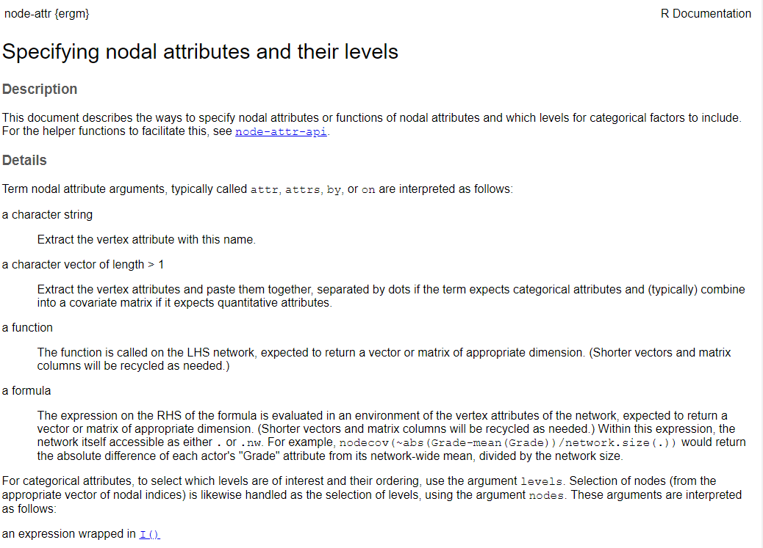
> ?("ergm-attr")

Slide 19
Anatomy of an InitErgmTerm function
InitErgmTerm.absdiff <- function(
nw, arglist, ..., version = packageVersion("ergm")) {
if (version <= as.package_version("3.9.4")) {
a <- check.ErgmTerm(nw, arglist, directed = NULL, bipartite = NULL,
varnames = c("attrname", "pow"),
vartypes = c("character", "numeric"),
defaultvalues = list(NULL, 1),
required = c(TRUE, FALSE))
nodecov <- get.node.attr(nw, a$attrname)
covname <- a$attrname }
else {
a <- check.ErgmTerm(nw, arglist, directed = NULL, bipartite = NULL,
varnames = c("attr", "pow"),
vartypes = c(ERGM_VATTR_SPEC, "numeric"),
defaultvalues = list(NULL, 1),
required = c(TRUE, FALSE))
nodecov <- ergm_get_vattr(a$attr, nw, accept = "numeric")
covname <- attr(nodecov, "name")
}
list(name = "absdiff",
coef.names = paste(paste("absdiff", if (a$pow != 1) a$pow else "", sep = ""), covname, sep = "."),
inputs = c(a$pow, nodecov),
dependence = FALSE)
}

Slide 20
Anatomy of an InitErgmTerm function
1. Function call
InitErgmTerm.absdiff <- function(
nw, arglist, ..., version = packageVersion("ergm")) {
if (version <= as.package_version("3.9.4")) {
a <- check.ErgmTerm(nw, arglist, directed = NULL, bipartite = NULL,
varnames = c("attrname", "pow"),
vartypes = c("character", "numeric"),
defaultvalues = list(NULL, 1),
required = c(TRUE, FALSE))
nodecov <- get.node.attr(nw, a$attrname)
covname <- a$attrname }
else {
a <- check.ErgmTerm(nw, arglist, directed = NULL, bipartite = NULL,
varnames = c("attr", "pow"),
vartypes = c(ERGM_VATTR_SPEC, "numeric"),
defaultvalues = list(NULL, 1),
required = c(TRUE, FALSE))
nodecov <- ergm_get_vattr(a$attr, nw, accept = "numeric")
covname <- attr(nodecov, "name")
}
list(name = "absdiff",
coef.names = paste(paste("absdiff", if (a$pow != 1) a$pow else "", sep = ""), covname, sep = "."),
inputs = c(a$pow, nodecov),
dependence = FALSE)
}

Slide 21
Anatomy of an InitErgmTerm function
1a. Code for backwards compatibility *
InitErgmTerm.absdiff <- function(
nw, arglist, ..., version = packageVersion("ergm")) {
if (version <= as.package_version("3.9.4")) {
a <- check.ErgmTerm(nw, arglist, directed = NULL, bipartite = NULL,
varnames = c("attrname", "pow"),
vartypes = c("character", "numeric"),
defaultvalues = list(NULL, 1),
required = c(TRUE, FALSE))
nodecov <- get.node.attr(nw, a$attrname)
covname <- a$attrname }
else {
a <- check.ErgmTerm(nw, arglist, directed = NULL, bipartite = NULL,
varnames = c("attr", "pow"),
vartypes = c(ERGM_VATTR_SPEC, "numeric"),
defaultvalues = list(NULL, 1),
required = c(TRUE, FALSE))
nodecov <- ergm_get_vattr(a$attr, nw, accept = "numeric")
covname <- attr(nodecov, "name")
}
list(name = "absdiff",
coef.names = paste(paste("absdiff", if (a$pow != 1) a$pow else "", sep = ""), covname, sep = "."),
inputs = c(a$pow, nodecov),
dependence = FALSE)
}
* Not your problem when writing a new statistic

Slide 22
Anatomy of an InitErgmTerm function
InitErgmTerm.absdiff <- function(nw, arglist, ...,) {
a <- check.ErgmTerm(nw, arglist, directed = NULL, bipartite = NULL,
varnames = c("attr", "pow"),
vartypes = c(ERGM_VATTR_SPEC, "numeric"),
defaultvalues = list(NULL, 1),
required = c(TRUE, FALSE))
nodecov <- ergm_get_vattr(a$attr, nw, accept = "numeric")
covname <- attr(nodecov, "name")
list(name = "absdiff",
coef.names = paste(paste("absdiff", if (a$pow != 1) a$pow else "", sep = ""), covname, sep = "."),
inputs = c(a$pow, nodecov),
dependence = FALSE)
}

Slide 23
Anatomy of an InitErgmTerm function
2. Checking input
InitErgmTerm.absdiff <- function(nw, arglist, ...,) {
a <- check.ErgmTerm(nw, arglist, directed = NULL, bipartite = NULL,
varnames = c("attr", "pow"),
vartypes = c(ERGM_VATTR_SPEC, "numeric"),
defaultvalues = list(NULL, 1),
required = c(TRUE, FALSE))
nodecov <- ergm_get_vattr(a$attr, nw, accept = "numeric")
covname <- attr(nodecov, "name")
list(name = "absdiff",
coef.names = paste(paste("absdiff", if (a$pow != 1) a$pow else "", sep = ""), covname, sep = "."),
inputs = c(a$pow, nodecov),
dependence = FALSE)
}

Slide 24
Anatomy of an InitErgmTerm function
3. Processing input (optional)
InitErgmTerm.absdiff <- function(nw, arglist, ...,) {
a <- check.ErgmTerm(nw, arglist, directed = NULL, bipartite = NULL,
varnames = c("attr", "pow"),
vartypes = c(ERGM_VATTR_SPEC, "numeric"),
defaultvalues = list(NULL, 1),
required = c(TRUE, FALSE))
nodecov <- ergm_get_vattr(a$attr, nw, accept = "numeric")
covname <- attr(nodecov, "name")
list(name = "absdiff",
coef.names = paste(paste("absdiff", if (a$pow != 1) a$pow else "", sep = ""), covname, sep = "."),
inputs = c(a$pow, nodecov),
dependence = FALSE)
}

Slide 25
Anatomy of an InitErgmTerm function
4. Constructing output
InitErgmTerm.absdiff <- function(nw, arglist, ...,) {
a <- check.ErgmTerm(nw, arglist, directed = NULL, bipartite = NULL,
varnames = c("attr", "pow"),
vartypes = c(ERGM_VATTR_SPEC, "numeric"),
defaultvalues = list(NULL, 1),
required = c(TRUE, FALSE))
nodecov <- ergm_get_vattr(a$attr, nw, accept = "numeric")
covname <- attr(nodecov, "name")
list(name = "absdiff",
coef.names = paste(paste("absdiff", if (a$pow != 1) a$pow else "", sep = ""), covname, sep = "."),
inputs = c(a$pow, nodecov),
dependence = FALSE)
}

Slide 26
Anatomy of an InitErgmTerm function
1. Function call
only thing you need to change is the name
InitErgmTerm.absdiff <- function(nw, arglist, ...,) {
a <- check.ErgmTerm(nw, arglist, directed = NULL, bipartite = NULL,
varnames = c("attr", "pow"),
vartypes = c(ERGM_VATTR_SPEC, "numeric"),
defaultvalues = list(NULL, 1),
required = c(TRUE, FALSE))
nodecov <- ergm_get_vattr(a$attr, nw, accept = "numeric")
covname <- attr(nodecov, "name")
list(name = "absdiff",
coef.names = paste(paste("absdiff", if (a$pow != 1) a$pow else "", sep = ""), covname, sep = "."),
inputs = c(a$pow, nodecov),
dependence = FALSE)
}

Slide 27
Anatomy of an InitErgmTerm function
2. Checking input
Check network and argument (don’t change)
Let R know if OK for directed/undirected, bipartite/non-bipartite
List arguments, and specify their type, default value and whether required
InitErgmTerm.absdiff <- function(nw, arglist, ...,) {
a <- check.ErgmTerm(nw, arglist, directed = NULL, bipartite = NULL,
varnames = c("attr", "pow"),
vartypes = c(ERGM_VATTR_SPEC, "numeric"),
defaultvalues = list(NULL, 1),
required = c(TRUE, FALSE))
nodecov <- ergm_get_vattr(a$attr, nw, accept = "numeric")
covname <- attr(nodecov, "name")
list(name = "absdiff",
coef.names = paste(paste("absdiff", if (a$pow != 1) a$pow else "", sep = ""), covname, sep = "."),
inputs = c(a$pow, nodecov),
dependence = FALSE)
}

Slide 28
directed= TRUE works for directed networks only
FALSE works for undirected networks only
NULL works for either
bipartite= TRUE works for bipartite networks only
FALSE works for unipartite networks only
NULL works for either

Slide 29
Anatomy of an InitErgmTerm function
2. Checking input
Check network and argument (don’t change)
Let R know if OK for directed/undirected, bipartite/non-bipartite
List arguments, and specify their type, default value and whether required
InitErgmTerm.absdiff <- function(nw, arglist, ...,) {
a <- check.ErgmTerm(nw, arglist, directed = NULL, bipartite = NULL,
varnames = c("attr", "pow"),
vartypes = c(ERGM_VATTR_SPEC, "numeric"),
defaultvalues = list(NULL, 1),
required = c(TRUE, FALSE))
nodecov <- ergm_get_vattr(a$attr, nw, accept = "numeric")
covname <- attr(nodecov, "name")
list(name = "absdiff",
coef.names = paste(paste("absdiff", if (a$pow != 1) a$pow else "", sep = ""), covname, sep = "."),
inputs = c(a$pow, nodecov),
dependence = FALSE)
}

Slide 30
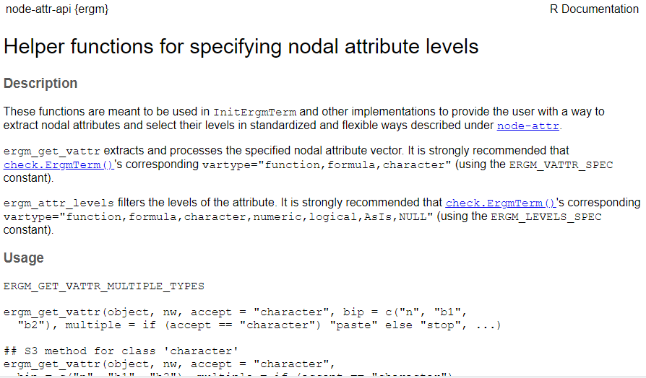
> ?(“node-attr-api")

Slide 31
Anatomy of an InitErgmTerm function
3. Processing output
Pulling values of arguments out from a
Processing them in any way needed for passing
InitErgmTerm.absdiff <- function(nw, arglist, ...,) {
a <- check.ErgmTerm(nw, arglist, directed = NULL, bipartite = NULL,
varnames = c("attr", "pow"),
vartypes = c(ERGM_VATTR_SPEC, "numeric"),
defaultvalues = list(NULL, 1),
required = c(TRUE, FALSE))
nodecov <- ergm_get_vattr(a$attr, nw, accept = "numeric")
covname <- attr(nodecov, "name")
list(name = "absdiff",
coef.names = paste(paste("absdiff", if (a$pow != 1) a$pow else "", sep = ""), covname, sep = "."),
inputs = c(a$pow, nodecov),
dependence = FALSE)
}

Slide 32
Anatomy of an InitErgmTerm function
4. Constructing output
C function name (w/o the d_)
Coefficient name
Inputs to pass to c function
Whether dyadic dependent
Empty network stats (opt.)
No need to pass the network
InitErgmTerm.absdiff <- function(nw, arglist, ...,) {
a <- check.ErgmTerm(nw, arglist, directed = NULL, bipartite = NULL,
varnames = c("attr", "pow"),
vartypes = c(ERGM_VATTR_SPEC, "numeric"),
defaultvalues = list(NULL, 1),
required = c(TRUE, FALSE))
nodecov <- ergm_get_vattr(a$attr, nw, accept = "numeric")
covname <- attr(nodecov, "name")
list(name = "absdiff",
coef.names = paste(paste("absdiff", if (a$pow != 1) a$pow else "", sep = ""), covname, sep = "."),
inputs = c(a$pow, nodecov),
dependence = FALSE)
}

Slide 33
Anatomy of a d_ function
D_CHANGESTAT_FN(d_absdiff) {
double change, p;
Vertex tail, head;
int i;
/* *** don't forget tail -> head */
ZERO_ALL_CHANGESTATS(i);
FOR_EACH_TOGGLE(i) {
tail = TAIL(i);
head = HEAD(i);
p = INPUT_ATTRIB[0];
if(p==1.0){
change = fabs(INPUT_ATTRIB[tail] - INPUT_ATTRIB[head]);
} else {
change = pow(fabs(INPUT_ATTRIB[tail] - INPUT_ATTRIB[head]), p);
}
CHANGE_STAT[0] += IS_OUTEDGE(tail,head) ? -change : change;
TOGGLE_IF_MORE_TO_COME(i); /* Needed in case of multiple toggles */
}
UNDO_PREVIOUS_TOGGLES(i); /* Needed on exit in case of multiple toggles */
}

Slide 34
Anatomy of a d_ function
1. Function call
D_CHANGESTAT_FN(d_absdiff) {
double change, p;
Vertex tail, head;
int i;
/* *** don't forget tail -> head */
ZERO_ALL_CHANGESTATS(i);
FOR_EACH_TOGGLE(i) {
tail = TAIL(i);
head = HEAD(i);
p = INPUT_ATTRIB[0];
if(p==1.0){
change = fabs(INPUT_ATTRIB[tail] - INPUT_ATTRIB[head]);
} else {
change = pow(fabs(INPUT_ATTRIB[tail] - INPUT_ATTRIB[head]), p);
}
CHANGE_STAT[0] += IS_OUTEDGE(tail,head) ? -change : change;
TOGGLE_IF_MORE_TO_COME(i); /* Needed in case of multiple toggles */
}
UNDO_PREVIOUS_TOGGLES(i); /* Needed on exit in case of multiple toggles */
}

Slide 35
Anatomy of a d_ function
2. Variable declaration
D_CHANGESTAT_FN(d_absdiff) {
double change, p;
Vertex tail, head;
int i;
/* *** don't forget tail -> head */
ZERO_ALL_CHANGESTATS(i);
FOR_EACH_TOGGLE(i) {
tail = TAIL(i);
head = HEAD(i);
p = INPUT_ATTRIB[0];
if(p==1.0){
change = fabs(INPUT_ATTRIB[tail] - INPUT_ATTRIB[head]);
} else {
change = pow(fabs(INPUT_ATTRIB[tail] - INPUT_ATTRIB[head]), p);
}
CHANGE_STAT[0] += IS_OUTEDGE(tail,head) ? -change : change;
TOGGLE_IF_MORE_TO_COME(i); /* Needed in case of multiple toggles */
}
UNDO_PREVIOUS_TOGGLES(i); /* Needed on exit in case of multiple toggles */
}

Slide 36
Anatomy of a d_ function
3. Multiple toggle code *
*stay tuned for cool updates (see last slide for preview)
D_CHANGESTAT_FN(d_absdiff) {
double change, p;
Vertex tail, head;
int i;
/* *** don't forget tail -> head */
ZERO_ALL_CHANGESTATS(i);
FOR_EACH_TOGGLE(i) {
tail = TAIL(i);
head = HEAD(i);
p = INPUT_ATTRIB[0];
if(p==1.0){
change = fabs(INPUT_ATTRIB[tail] - INPUT_ATTRIB[head]);
} else {
change = pow(fabs(INPUT_ATTRIB[tail] - INPUT_ATTRIB[head]), p);
}
CHANGE_STAT[0] += IS_OUTEDGE(tail,head) ? -change : change;
TOGGLE_IF_MORE_TO_COME(i); /* Needed in case of multiple toggles */
}
UNDO_PREVIOUS_TOGGLES(i); /* Needed on exit in case of multiple toggles */
}

Slide 37
Anatomy of a d_ function
4. Change statistic calculation
D_CHANGESTAT_FN(d_absdiff) {
double change, p;
Vertex tail, head;
int i;
/* *** don't forget tail -> head */
ZERO_ALL_CHANGESTATS(i);
FOR_EACH_TOGGLE(i) {
tail = TAIL(i);
head = HEAD(i);
p = INPUT_ATTRIB[0];
if(p==1.0){
change = fabs(INPUT_ATTRIB[tail] - INPUT_ATTRIB[head]);
} else {
change = pow(fabs(INPUT_ATTRIB[tail] - INPUT_ATTRIB[head]), p);
}
CHANGE_STAT[0] += IS_OUTEDGE(tail,head) ? -change : change;
TOGGLE_IF_MORE_TO_COME(i); /* Needed in case of multiple toggles */
}
UNDO_PREVIOUS_TOGGLES(i); /* Needed on exit in case of multiple toggles */
}

Slide 38
Anatomy of a d_ function
1. Function call
only thing you need to change is the name
D_CHANGESTAT_FN(d_absdiff) {
double change, p;
Vertex tail, head;
int i;
/* *** don't forget tail -> head */
ZERO_ALL_CHANGESTATS(i);
FOR_EACH_TOGGLE(i) {
tail = TAIL(i);
head = HEAD(i);
p = INPUT_ATTRIB[0];
if(p==1.0){
change = fabs(INPUT_ATTRIB[tail] - INPUT_ATTRIB[head]);
} else {
change = pow(fabs(INPUT_ATTRIB[tail] - INPUT_ATTRIB[head]), p);
}
CHANGE_STAT[0] += IS_OUTEDGE(tail,head) ? -change : change;
TOGGLE_IF_MORE_TO_COME(i); /* Needed in case of multiple toggles */
}
UNDO_PREVIOUS_TOGGLES(i); /* Needed on exit in case of multiple toggles */
}

Slide 39
Anatomy of a d_ function
2. Variable declaration
Declare all variables you use (easiest to do at the end)
We’ve created two extra variable types available: Vertex and Edge
D_CHANGESTAT_FN(d_absdiff) {
double change, p;
Vertex tail, head;
int i;
/* *** don't forget tail -> head */
ZERO_ALL_CHANGESTATS(i);
FOR_EACH_TOGGLE(i) {
tail = TAIL(i);
head = HEAD(i);
p = INPUT_ATTRIB[0];
if(p==1.0){
change = fabs(INPUT_ATTRIB[tail] - INPUT_ATTRIB[head]);
} else {
change = pow(fabs(INPUT_ATTRIB[tail] - INPUT_ATTRIB[head]), p);
}
CHANGE_STAT[0] += IS_OUTEDGE(tail,head) ? -change : change;
TOGGLE_IF_MORE_TO_COME(i); /* Needed in case of multiple toggles */
}
UNDO_PREVIOUS_TOGGLES(i); /* Needed on exit in case of multiple toggles */
}

Slide 40
Anatomy of a d_ function
3. Multiple toggle code
Don’t change a thing!
D_CHANGESTAT_FN(d_absdiff) {
double change, p;
Vertex tail, head;
int i;
/* *** don't forget tail -> head */
ZERO_ALL_CHANGESTATS(i);
FOR_EACH_TOGGLE(i) {
tail = TAIL(i);
head = HEAD(i);
p = INPUT_ATTRIB[0];
if(p==1.0){
change = fabs(INPUT_ATTRIB[tail] - INPUT_ATTRIB[head]);
} else {
change = pow(fabs(INPUT_ATTRIB[tail] - INPUT_ATTRIB[head]), p);
}
CHANGE_STAT[0] += IS_OUTEDGE(tail,head) ? -change : change;
TOGGLE_IF_MORE_TO_COME(i); /* Needed in case of multiple toggles */
}
UNDO_PREVIOUS_TOGGLES(i); /* Needed on exit in case of multiple toggles */
}

Slide 41
Anatomy of a d_ function
4. Change statistic calculation
Pull out the tail and head of the toggle
Pull out other parameters passed, by position
D_CHANGESTAT_FN(d_absdiff) {
double change, p;
Vertex tail, head;
int i;
/* *** don't forget tail -> head */
ZERO_ALL_CHANGESTATS(i);
FOR_EACH_TOGGLE(i) {
tail = TAIL(i);
head = HEAD(i);
p = INPUT_ATTRIB[0];
if(p==1.0){
change = fabs(INPUT_ATTRIB[tail] - INPUT_ATTRIB[head]);
} else {
change = pow(fabs(INPUT_ATTRIB[tail] - INPUT_ATTRIB[head]), p);
}
CHANGE_STAT[0] += IS_OUTEDGE(tail,head) ? -change : change;
TOGGLE_IF_MORE_TO_COME(i); /* Needed in case of multiple toggles */
}
UNDO_PREVIOUS_TOGGLES(i); /* Needed on exit in case of multiple toggles */
}

Slide 42
Never forget:
R indexes vectors beginning with 1
C indexes vectors beginning with 0

Slide 43
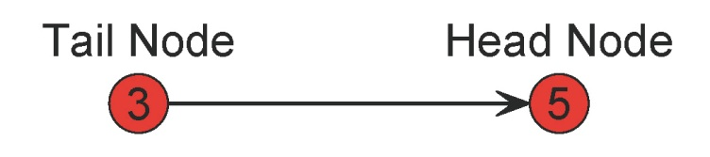
Network storage in ergm
Directed network
represents both: an outedge from 3 to 5
an inedge 5 to 3
IS_OUTEDGE(3,5) 1 (true)
IS_INEDGE(5,3) 1 (true)
IS_OUTEDGE(5,3) 0 (false)
IS_INEDGE(3,5) 0 (false)
Undirected network stored as directed
tail node < head node

Slide 44
Examples of macros
Found in changestat.h in the src directory of the ergm source code folder
[NB: It’s a good idea to obtain the source code for the ergm package!]
TAIL(i) ID of tail node in toggle i
HEAD(i) ID of head node in toggle i
IS_OUTEDGE(a,b) 1/0 for whether edge a->b exists
IS_INEDGE(a,b) 1/0 for whether edge a<-b exists
IS_UNDIRECTED_EDGE(a,b) 1/0 for whether edge a--b exists
OUT_DEG[a] outdegree of node a
IN_DEG[a] indegree of node a
N_EDGES total # of edges in the network currently
N_NODES total # of nodes in the network
N_DYADS total # of dyads in the network
DIRECTED 1 if network is directed, 0 if directed
INPUT_PARAM inputs passed from R
N_INPUT_PARAMS number of inputs passed from R
STEP_THROUGH_OUTEDGES(a,e,v) : sets up loop to go through all of node a’s outedges, indexed by v

Slide 45
Anatomy of a d_ function
4. Change statistic calculation
Calculate change statistic for i,j (often with conditionals)
Common practice: flip sign for dissolution toggle
D_CHANGESTAT_FN(d_absdiff) {
double change, p;
Vertex tail, head;
int i;
/* *** don't forget tail -> head */
ZERO_ALL_CHANGESTATS(i);
FOR_EACH_TOGGLE(i) {
tail = TAIL(i);
head = HEAD(i);
p = INPUT_ATTRIB[0];
if(p==1.0){
change = fabs(INPUT_ATTRIB[tail] - INPUT_ATTRIB[head]);
} else {
change = pow(fabs(INPUT_ATTRIB[tail] - INPUT_ATTRIB[head]), p);
}
CHANGE_STAT[0] += IS_OUTEDGE(tail,head) ? -change : change;
TOGGLE_IF_MORE_TO_COME(i); /* Needed in case of multiple toggles */
}
UNDO_PREVIOUS_TOGGLES(i); /* Needed on exit in case of multiple toggles */
}

Slide 46
Example: mymindegree
We want a term that
Works on undirected, non-bipartite networks only
Refers to the number of nodes in the network of at least degree x
Only needs to handle one value of x, not a whole vector

Slide 47
InitErgmTerm.absdiff <- function(nw, arglist, ...,) {
a <- check.ErgmTerm(nw, arglist, directed = NULL, bipartite = NULL,
varnames = c("attr", "pow"),
vartypes = c(ERGM_VATTR_SPEC, "numeric"),
defaultvalues = list(NULL, 1),
required = c(TRUE, FALSE))
nodecov <- ergm_get_vattr(a$attr, nw, accept = "numeric")
covname <- attr(nodecov, "name")
list(name = "absdiff",
coef.names = paste(paste("absdiff", if (a$pow != 1) a$pow else "", sep = ""), covname, sep = "."),
inputs = c(a$pow, nodecov),
dependence = FALSE)
}
D_CHANGESTAT_FN(d_absdiff) {
double change, p;
Vertex tail, head;
int i;
/* *** don't forget tail -> head */
ZERO_ALL_CHANGESTATS(i);
FOR_EACH_TOGGLE(i) {
tail = TAIL(i);
head = HEAD(i);
p = INPUT_ATTRIB[0];
if(p==1.0){
change = fabs(INPUT_ATTRIB[tail] - INPUT_ATTRIB[head]);
} else {
change = pow(fabs(INPUT_ATTRIB[tail] - INPUT_ATTRIB[head]), p);
}
CHANGE_STAT[0] += IS_OUTEDGE(tail,head) ? -change : change;
TOGGLE_IF_MORE_TO_COME(i); /* Needed in case of multiple toggles */
}
UNDO_PREVIOUS_TOGGLES(i); /* Needed on exit in case of multiple toggles */
}

Slide 48
Put it all together:
Put the R code in its own file named *.R in the R directory of your ergm.userterms source code, or at the end of the file “InitErgmTerm.users.R” I that directory
Put the C code at the end of the file “changestats.users.c” in the src directory of your ergm.userterms source code directory
In Rstudio, select Build > Build and Reload
Use your new term!!

Slide 49
Bonus: tweak the term
Add an attribute (either for the ego or the alters)
Have it take a vector of mindegrees
Something else creative and new
Bonus: code up something else altogether!
Show off the code to the crowd

Slide 50
Looking forward
D_CHANGESTAT_FN(d_edges) {
int edgeflag, i;
ZERO_ALL_CHANGESTATS(i);
FOR_EACH_TOGGLE(i) {
{
edgeflag = IS_OUTEDGE(TAIL(i), HEAD(i));
CHANGE_STAT[0] += edgeflag ? - 1 : 1;
TOGGLE_IF_MORE_TO_COME(i);
}
UNDO_PREVIOUS_TOGGLES(i);
}
D_CHANGESTAT_FN(d_absdiff) {
double change, p; Vertex tail, head; int i;
ZERO_ALL_CHANGESTATS(i);
FOR_EACH_TOGGLE(i) {
tail = TAIL(i); head = HEAD(i);
p = INPUT_ATTRIB[0];
if(p==1.0){
change = fabs(INPUT_ATTRIB[tail] - INPUT_ATTRIB[head]);
} else {
change = pow(fabs(INPUT_ATTRIB[tail] - INPUT_ATTRIB[head]), p);
}
CHANGE_STAT[0] += IS_OUTEDGE(tail,head) ? -change : change;
TOGGLE_IF_MORE_TO_COME(i);
} UNDO_PREVIOUS_TOGGLES(i);
D_CHANGESTAT_FN(d_absdiff) {
double change, p; p = INPUT_ATTRIB[0];
EXEC_THROUGH_TOGGLES(
{ if(p==1.0){ change = fabs(INPUT_ATTRIB[TAIL] - INPUT_ATTRIB[HEAD]); } else { change = pow(fabs(INPUT_ATTRIB[TAIL] - INPUT_ATTRIB[HEAD]), p); } CHANGE_STAT[0] += IS_OUTEDGE(TAIL,HEAD) ? -change : change; } }

